Slide 1
Statistics for Southern Water Corp
Dustin Na

Slide 2
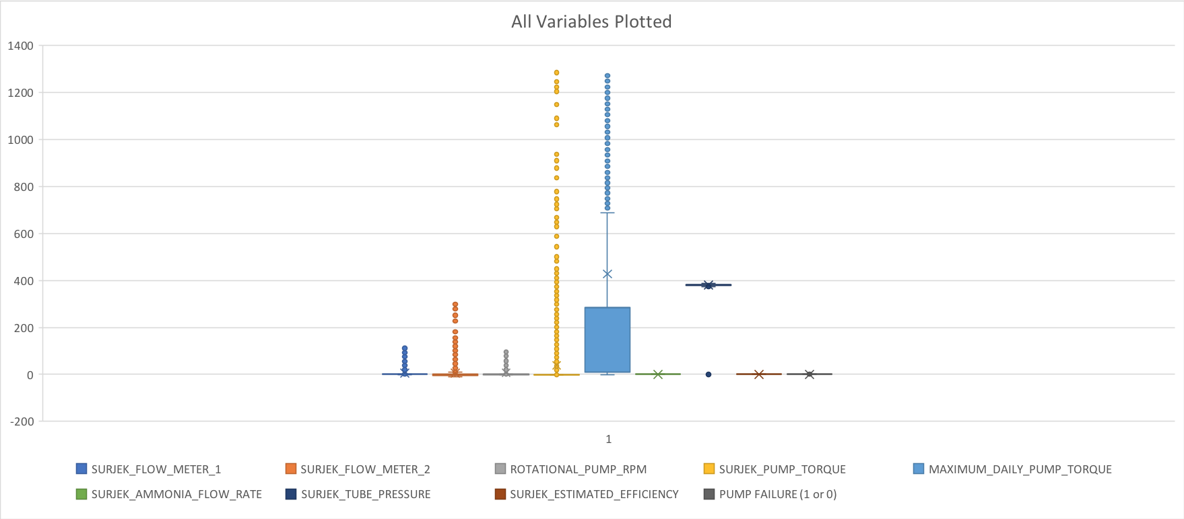
BoxPlots I

Slide 3
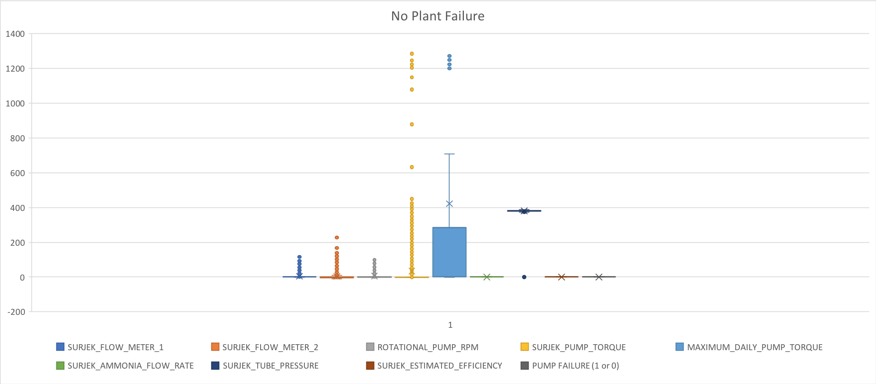
BoxPlots II

Slide 4
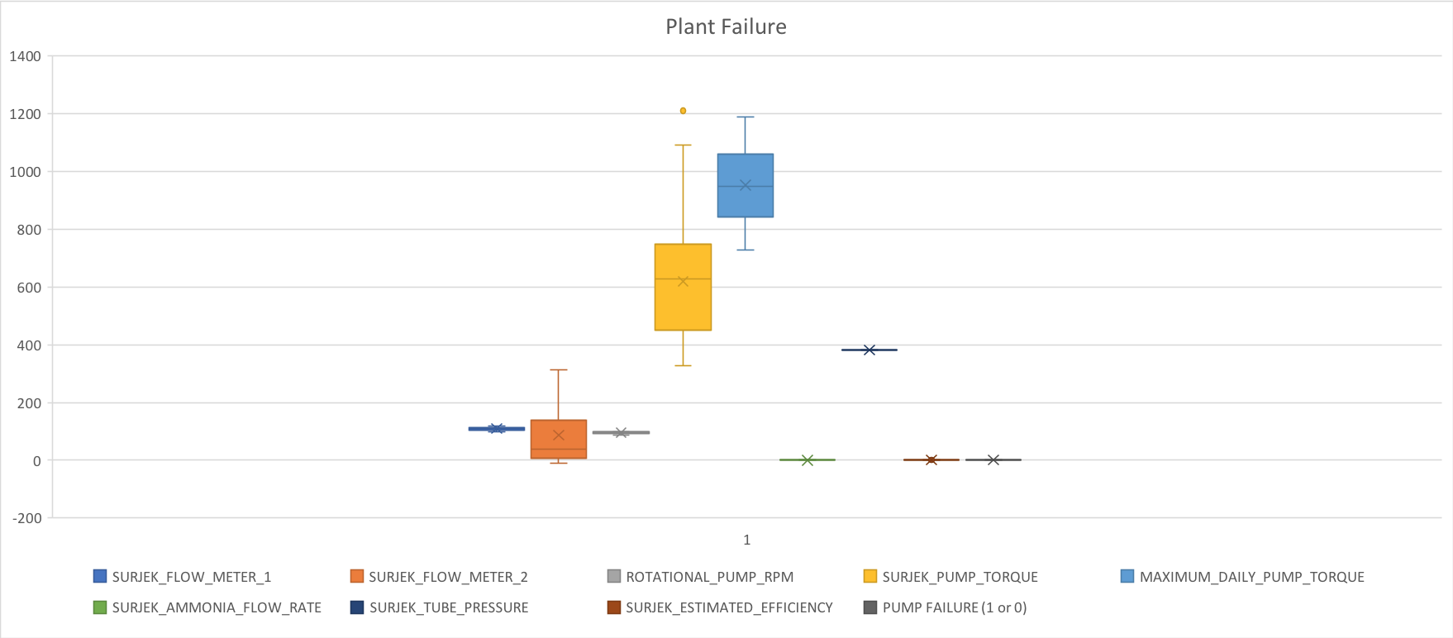
BoxPlots III

Slide 5
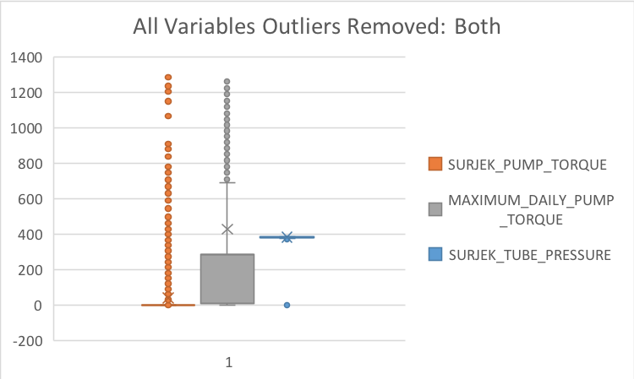
Outlier Removed Comparison I

Slide 6
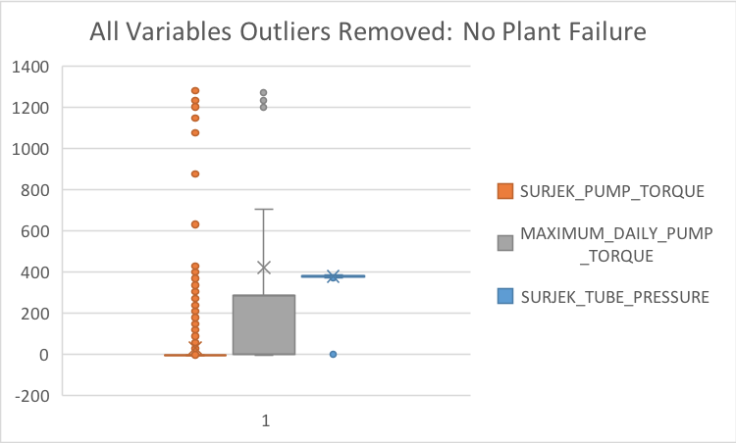
Outlier Removed Comparison II

Slide 7
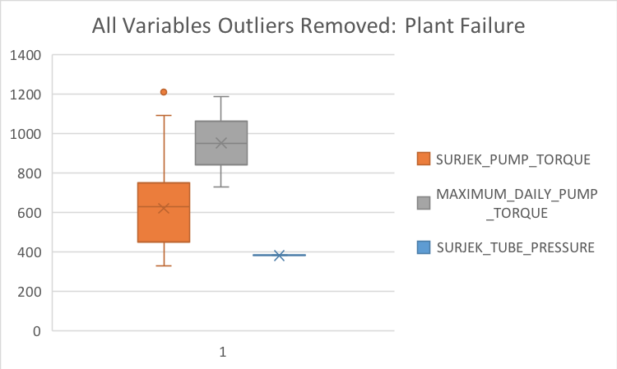
Outlier Removed Comparison III

Slide 8
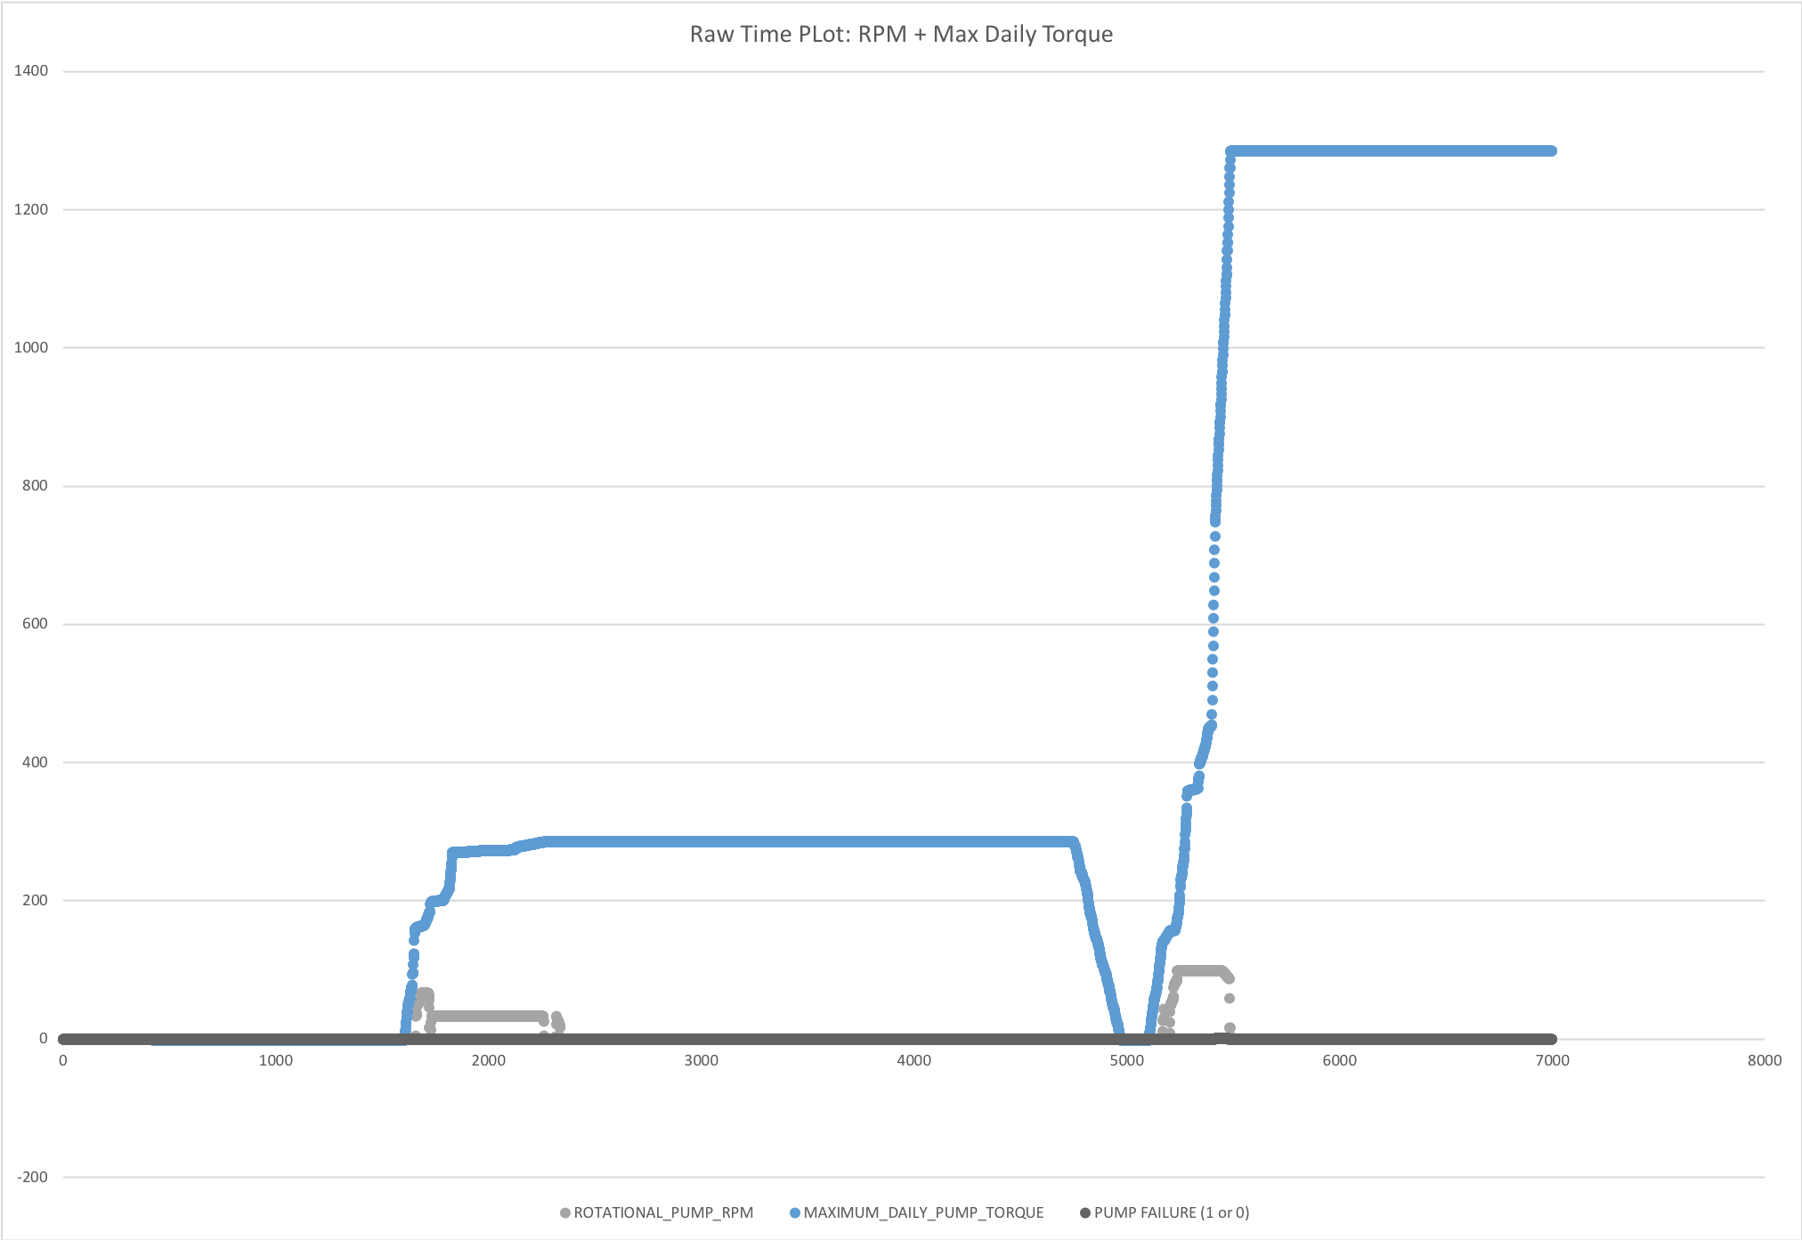
Raw Time Plot

Slide 9
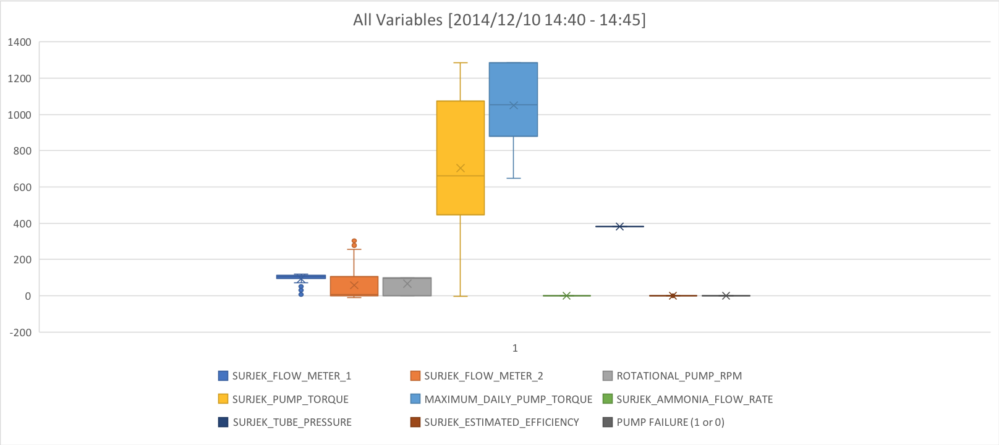
BoxPlot Re-Failure

Slide 10
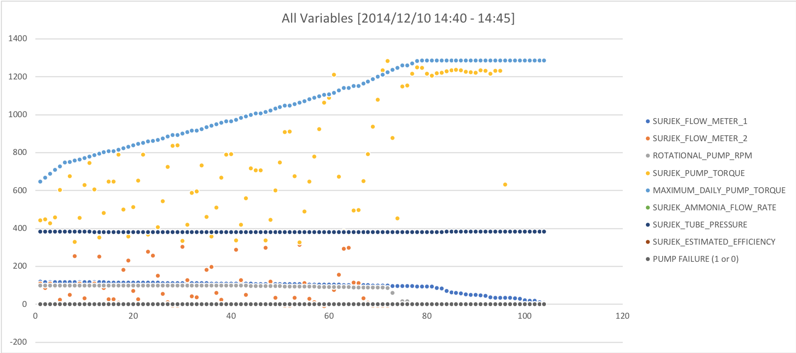
Rolling Std Dev [14:40 - 14:45]

Slide 11
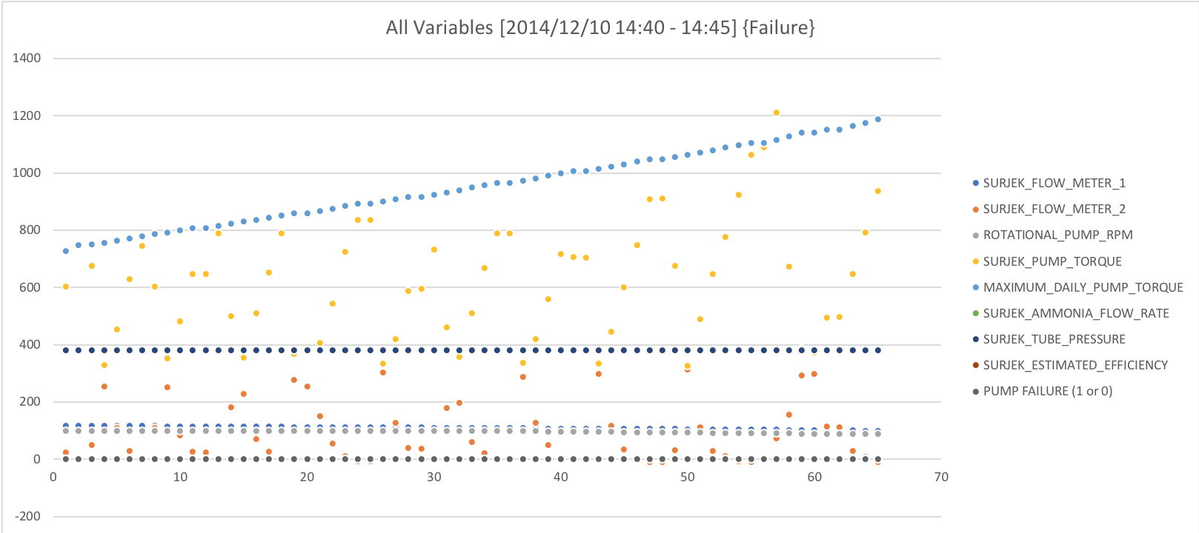
Rolling Std Dev [14:40 - 14:45] {Failure}

Slide 12
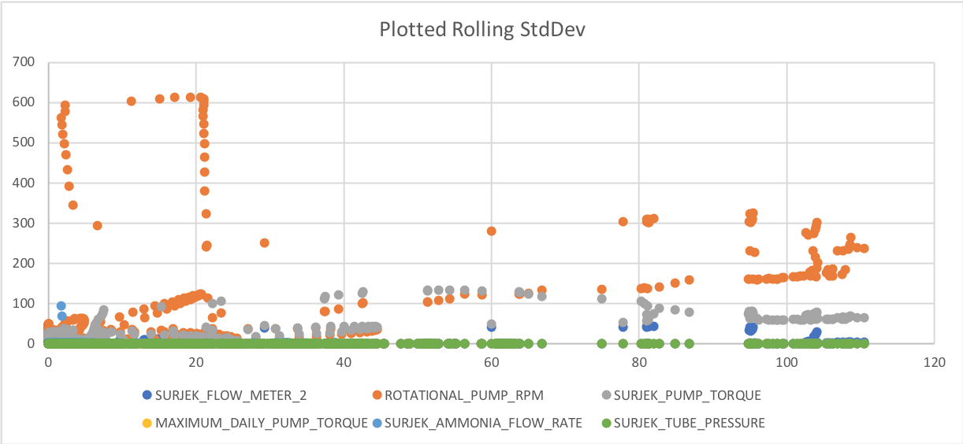
Plotted Rolling Std Dev [All Variables]

Slide 13
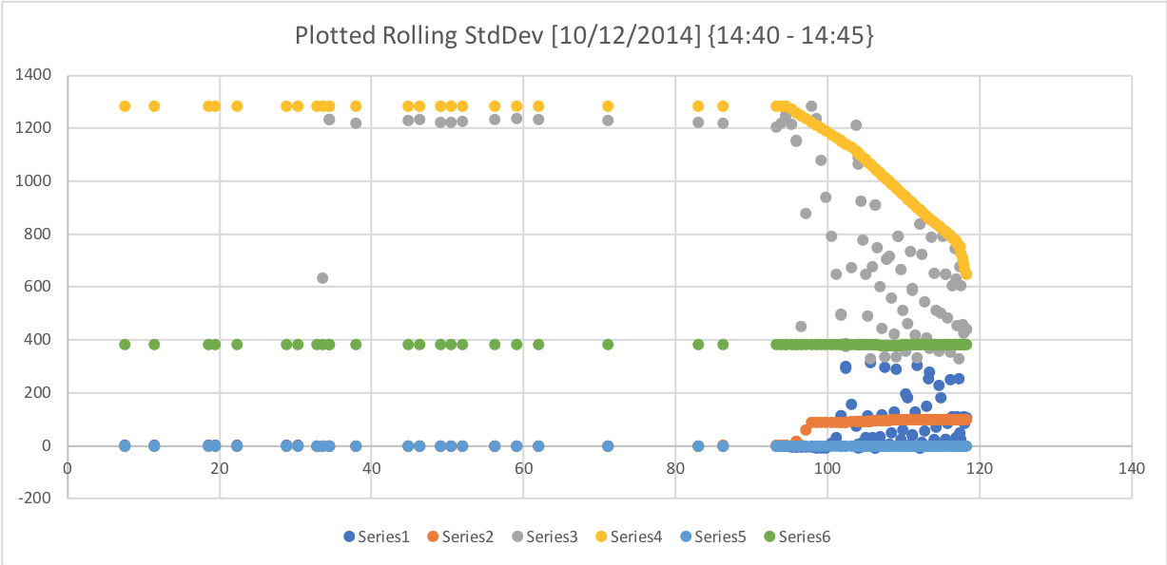
Plotted Rolling Std Dev [All Variables] {14:40 - 14:45}

Slide 14
According to my analysis, the variables that are most closely associated with Failure Mode are the following:
Surjek Flow Meter 2
Surjek Pump Torque
Maximum Daily Pump Torque

